Slide 1

Check In
Good morning. Please use the link or QR code to check yourself in. We will start shortly.
https://ww2.onetapcheckin.com/p#/checkin-v2?uniqueId=OVNce06VU5kF07ub7fmZM

Slide 2
About you
Please use the link below to write about yourself and your expectations from this skills bootcamp.
https://padlet.com/yusufs6/about-me-and-bootcamp-7f9b6rgo4zgx88nm

Slide 3
Schedule
Schedule of a Day
09:15-11:00 Training
11:00-11:15 Break
11:15-12:30 Training
12:30-13:30 Lunch Break
13:30-15:00 Training
15:00-15:15 Break
15:15-16:45 Training

Slide 4

What is a Skills Bootcamp?
Skill boot camps are intensive, short-term training programs in information technology fields.
Notes:
Image source: https://www.iberdrola.com/documents/20125/40558/beneficios_bootcamps_EN.jpg/0a6f3c70-1022-3fe6-ecdd-502cbbf81af7?t=1627457318072

Slide 5

Notes:
Image source: https://i.imgur.com/QZKylYc.png

Slide 6
Programme Outline
Bootcamp
A 4-day course over 12 weeks
2 days Technical Training
The rest of the time is for self-study, minimum of 14 hours per week
Careers support sessions will also take place

Slide 7
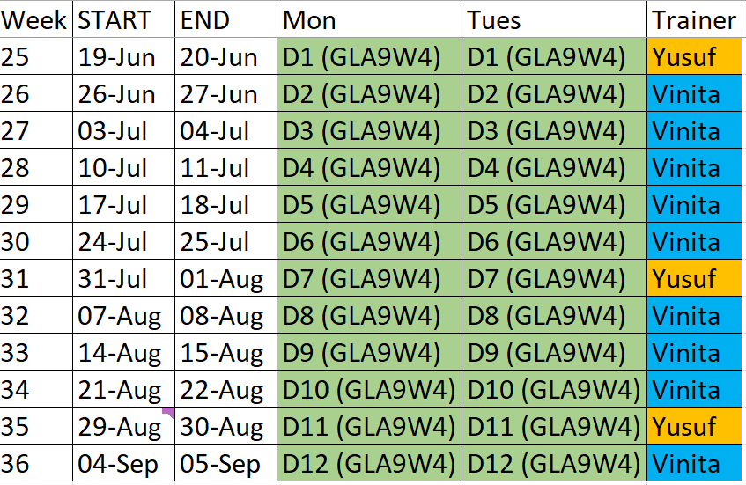


Schedule Overview

Slide 8
Recording
Guided learning session will be recorded.
Recordings will be available in Teams Recordings folder.
Recordings cannot be downloaded.
Recording cannot be shared with third parties.
The learners will have access to recording until the end of the bootcamp.

Slide 9
MS Teams and Other Tools
Download and install MS Teams app.
Join with your bootcamp email ID.
Follow channel calendar for schedule and posts.
Tools to download.
Tableau Public
PowerBI
Access
MySQL Workbench
Python Anaconda
R

Slide 10

Camera Expectations

Slide 11



Before we start… Please have your camera switched on.
Camera Expectations
This is a mandatory requirement for the duration of the course.
You are studying a regulated qualification, your tutor needs to see that it is the right person participating throughout the course.
Our job is to prepare you for work in an age where in almost any job there is likely to be at least some aspect of remote engagement with your employer.
Online learning is to be treated the same way as a classroom learning, you must be physically visible to interact with your tutor and other learners in order to create an engaging group dynamic.

Slide 12


Background filters
If you do not wish to have your camera displaying your personal environment, Microsoft Teams has a solution to this problem…
Step One: Before you join a Teams video call, click the ‘Background Filters’ option.
Step Two: On the right-hand side, you can select any of the stock images.
Step Three: The image you choose will then appear in your background on the video call.
If you need any further support in regards to this requirement, please speak to your tutor directly.

Slide 13

Designated Safeguarding Team Besafe@justit.co.uk Out of normal working times please refer to our website https://www.justit.co.uk/safeguarding/ for sources of information and support or contact the following agencies for immediate help. * The Samaritans https://www.samaritans.org/how-we-can-help/contact-samaritan/ * Mind https://www.mind.org.uk/information-support/ * Local authority support https://www.gov.uk/find-a-community-support-group-or-organisation * Anxiety UK https://www.anxietyuk.org.uk/ * Women's Aid https://www.womensaid.org.uk/information-support/ * Andy's Man Club https://andysmanclub.co.uk/
Safeguarding & Prevent

Slide 14
DAY 1 Spread Sheets

Slide 15
Aims & Objectives Development of Data using Excel
To understand and be able to work with data and making calculations
To understand the importance of document Security and be able to:
Prevent unauthorized users from opening or modifying workbooks
Control the changes users can make to workbooks
To understand the efficiency of the use of Functions and be able to work with:
Drop down lists
Filter
Sort

Slide 16
Formative Assessment
Students are requested to complete the following short assessment to help us identify what they know about the topic at present. Note: This is an ungraded assessment. It is okay if students do not know the answers yet.
Link to assessment: https://forms.office.com/Pages/ResponsePage.aspx?id=IA_9bshXR0S1PwDUmSylC9QnpiM2I7tDhSH-IzBN73pUQVY3SlA3VlNGU0JSRVNIUFoyVkxOUVJRNS4u

Slide 17
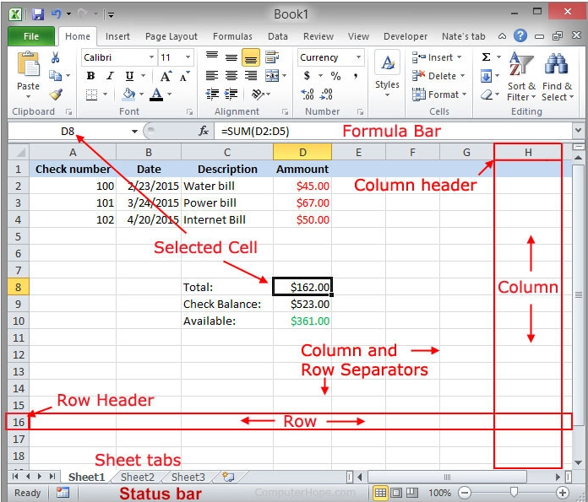
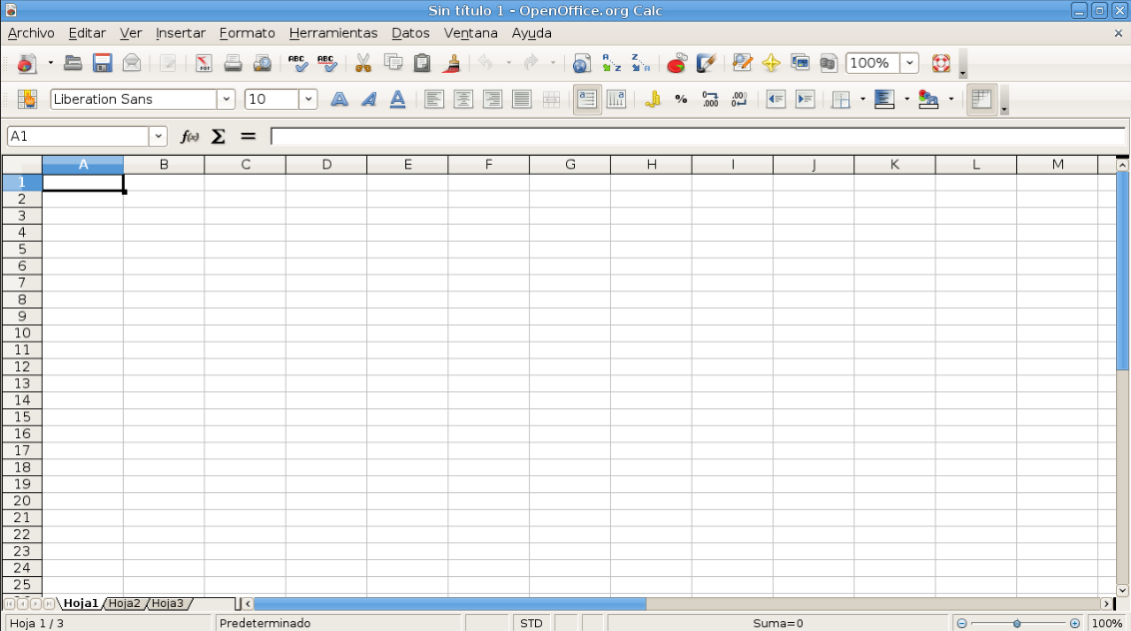
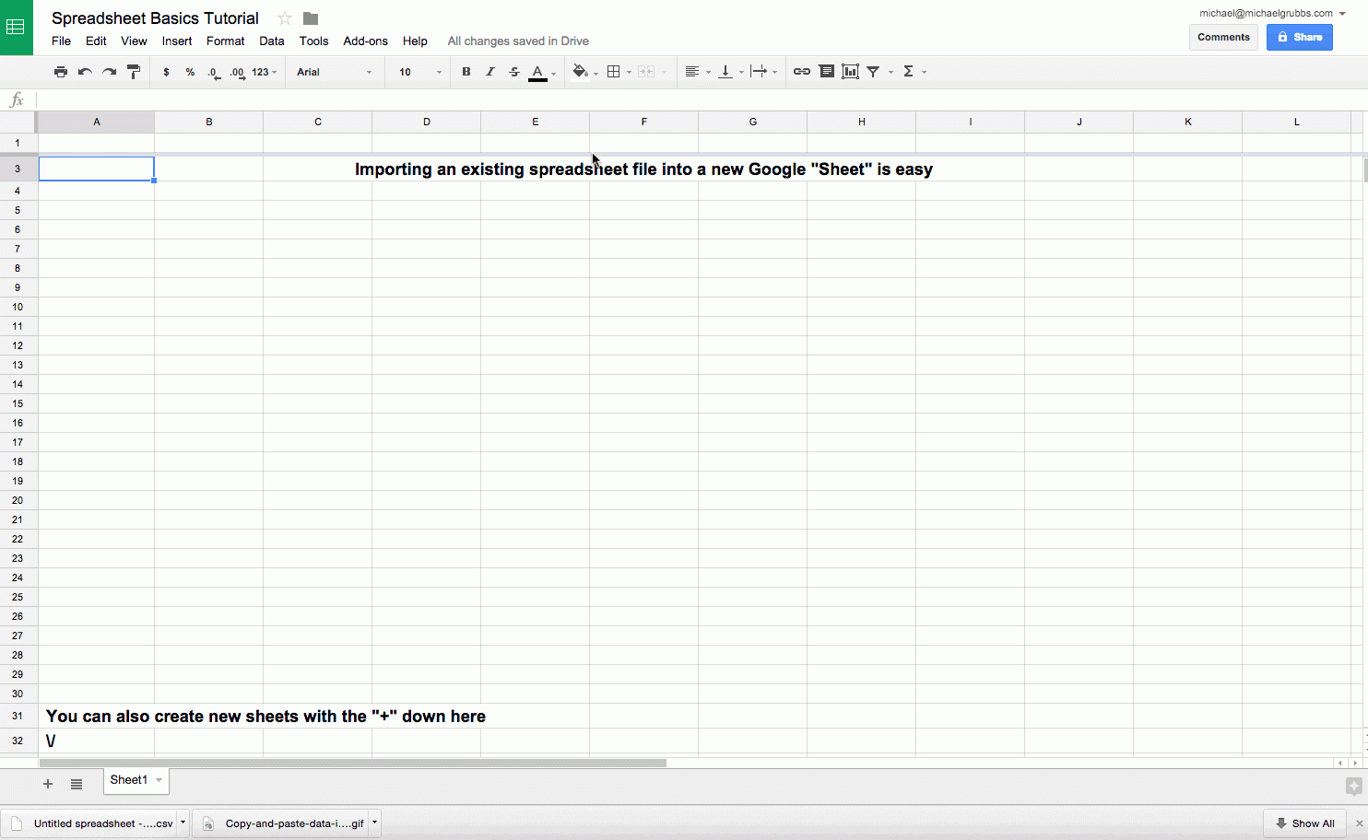
Basic Desktops for office 365 , Open Office and Google Sheets
Notes:
Learners will be able to follow with both office 365 desktop version and online versions. Also google sheets and Open office is also good to use. I would ask trainers to make sure you are familiar with the basics of all versions.

Slide 18
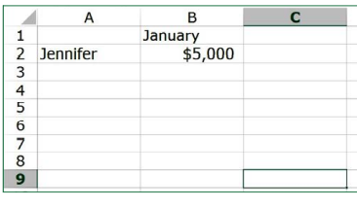
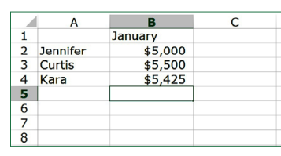
Your first spreadsheet formula
In cell B1, type “January”. This is the header for column B, which will display the monthly earnings for each person on the team.
Click on cell B2. Type “$5000” and hit Return/Enter.
In cell A3 (below “Jennifer”) type a new name: Curtis. In cell B3, type “$5500”. In cell A4 and B4, add “Kara” and “$5425”.
Your worksheet should now look like above right image.
Notes:
Once learners have opened up their preferred spreadsheet software .
Let’s do a quick exercise.
On the new spreadsheet you’ve just created, find cell A2. It should be the second cell from the top of column A. In it, type the name “Jennifer”, and press Return/Enter.

Slide 19
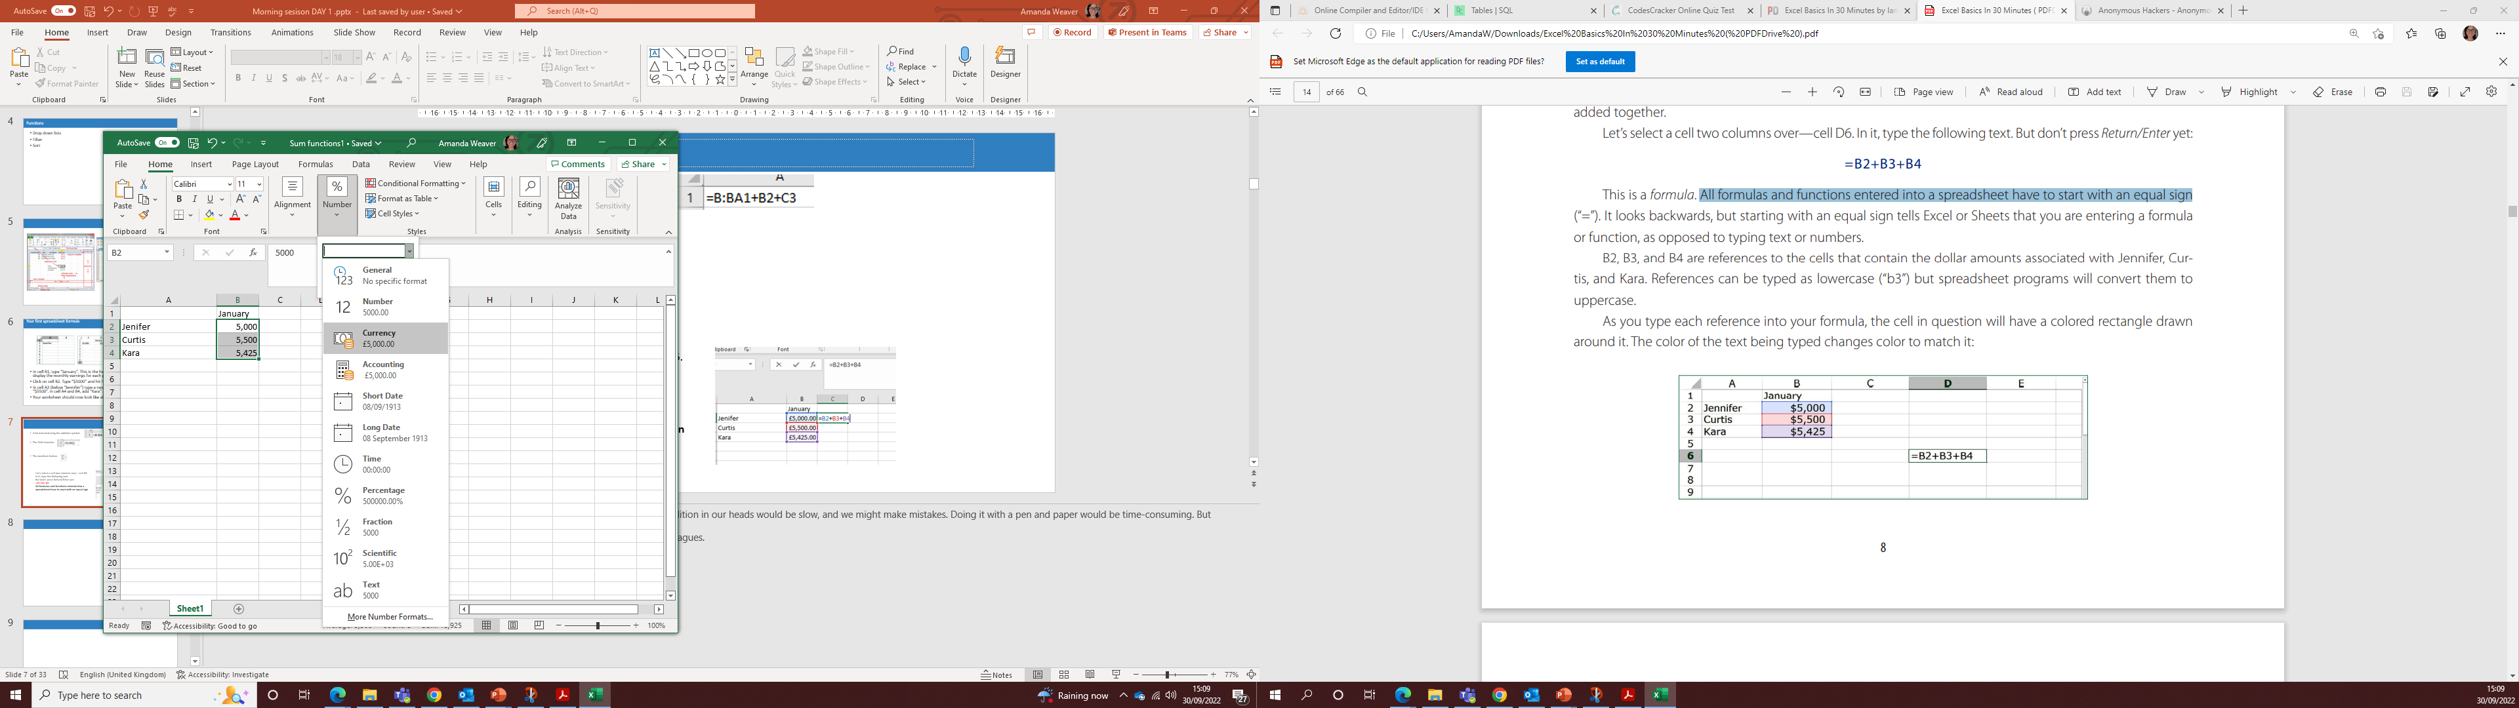
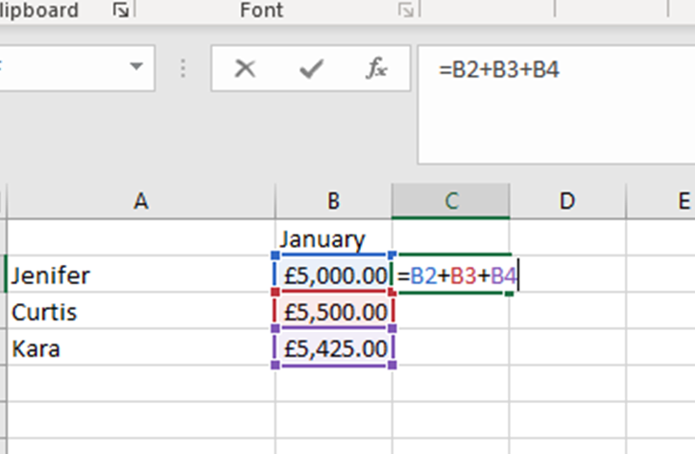
Basic functions = ,+
Task 1.
Firstly, we need to add £ pounds sign. On the Home tab find the icon ‘Number’ and select from the drop-down list ‘Currency’ .
Task 2.
Next let’s select a cell in columns C and cell 2. In it, type the following text =B2+B3+B4. Press the Return/Enter key to see the result. £15,925.00
Note: All formulas and functions entered into a spreadsheet have to start with an equal sign
Notes:
Next we wanted to add up the amounts to determine how much money the group collectively earns. Doing the addition in our heads would be slow, and we might make mistakes. Doing it with a pen and paper would be time-consuming. But spreadsheets make it easy, using three different methods.
Let’s first use the addition symbol in a worksheet formula to calculate the collective earnings of the three colleagues.
£15,925.00

Slide 20
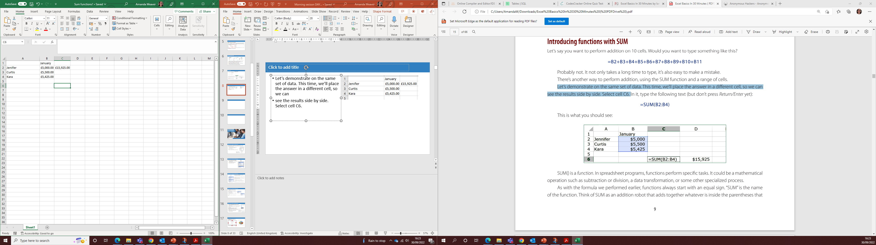
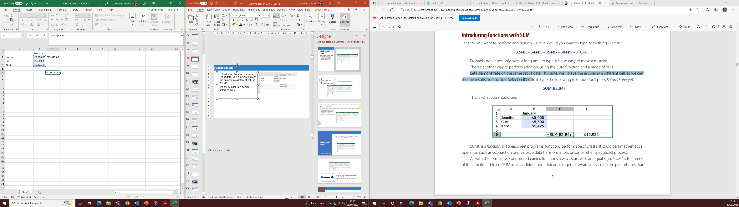
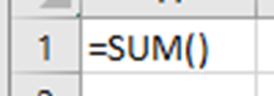
=SUM()
Let’s demonstrate on the same set of data. This time, we’ll place the answer in a different cell, so we can see the results side by side.
Select cell C6. and type the following =SUM(B2:B4)
Notes:
SUM() is a function. In spreadsheet programs, functions perform specific tasks. It could be a mathematical
operation such as subtraction or division, a data transformation, or some other specialized process. The text inside the parentheses—“B2:B4”—tells Excel to include the entire range of values that start with cell B2 and end with cell B4. In other words, it is the sum of the values in cells B2, B3, and B4. Press Return.

Slide 21
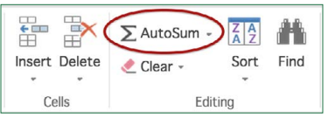
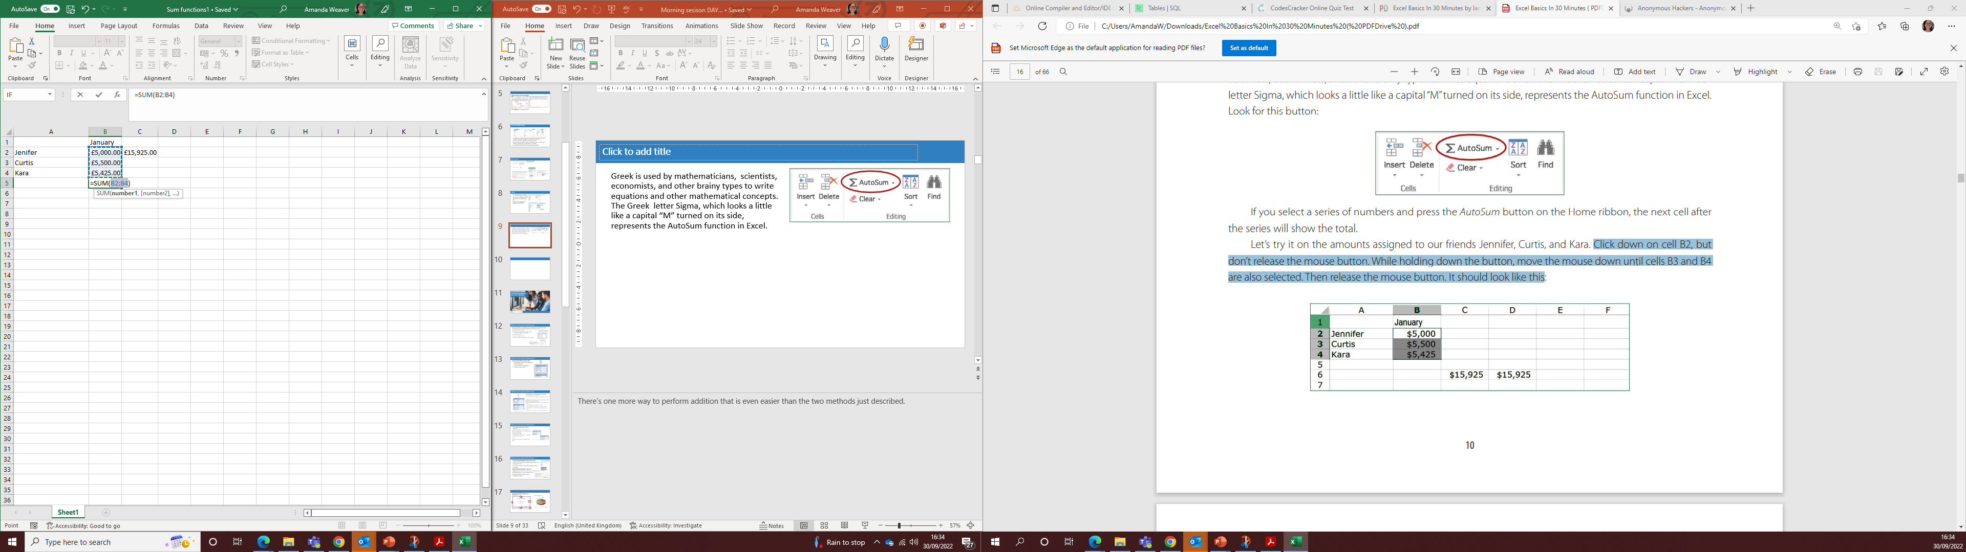
AutoSum
Greek is used by mathematicians, scientists, economists, and other brainy types to write equations and other mathematical concepts. The Greek letter Sigma, which looks a little like a capital “M” turned on its side, represents the AutoSum function in Excel.
Click down on cell B5 then move along the ribbon to find the AutoSum icon and select it, you should have the right image displayed the same as mine.
Notes:
There’s one more way to perform addition that is even easier than the two methods just described.

Slide 22

AutoFill magic
1. Select cell B1. This is the cell that contains “January.”
2. Hover the mouse pointer over the lower right corner of the highlighted cell until you see a small square dot or crosshair. Grab it with your mouse, and drag five cells to the right
3. Release the mouse button.
Notes:
One edit we can do is to remove the totals cell and move the function to the end of the January column. We can cut and past.

Slide 23


Dragging the function
Notes:
When we drag the formular across you can see that we have no visible numbers in some of the cells. This is easily remedied by hovering in-between the columns until you get a double ended arrow as above. Double click and the cells will open to fit the text . Apply to all columns

Slide 24
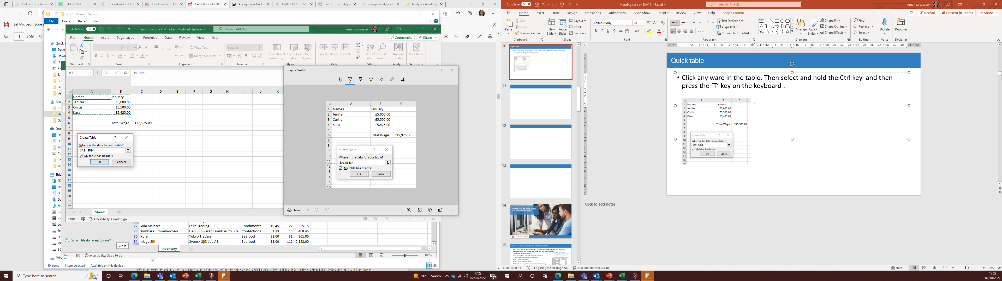
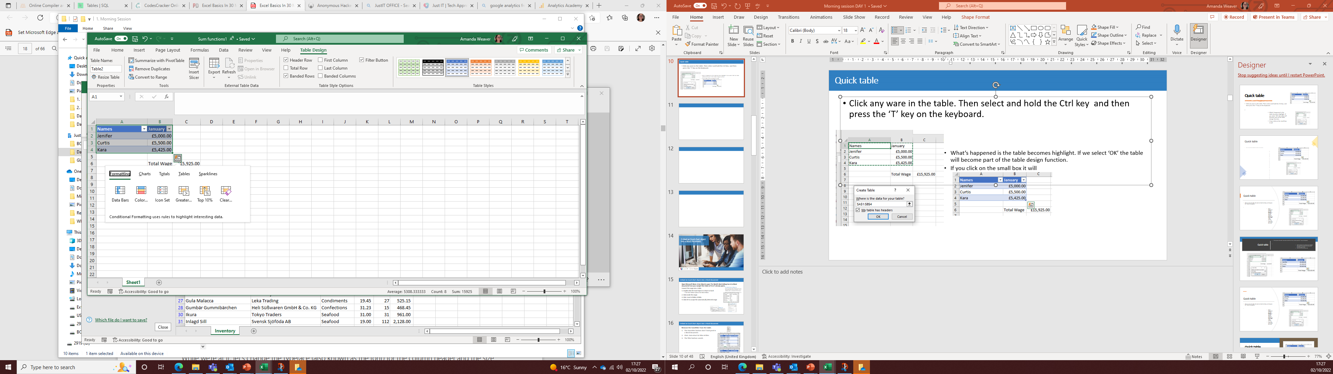
Quick table
Click any ware in the table. Then select and hold the Ctrl key and then press the ‘T’ key on the keyboard.
What’s happened is the table becomes highlight. If we select ‘OK’ the table will become part of the table design function.
If you click on the small box it will open up varia formatting tools we can use to enhance our table.
Notes:
Trainer to show all the formatting tools available from this pop out box. Do Not save. Go back to the original view.

Slide 25
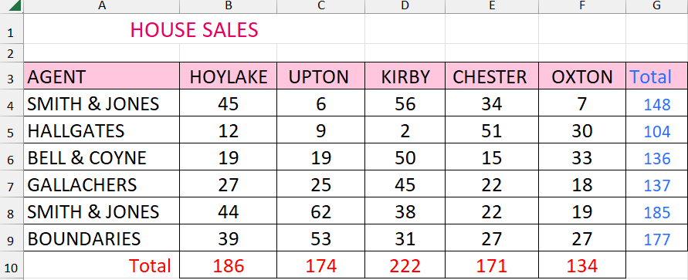
Activity – Open a new sheet and set up and format the table as below -10 minutes
Save as House Sales
If you complete before the time use CTRL+T and set out with a Table design- Save as version V2

Slide 26
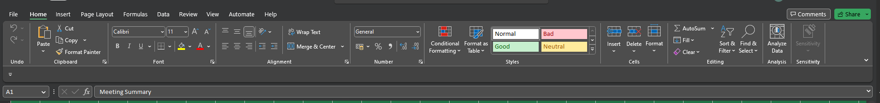
Recap Question
What is the name of the function to calculate the total in Excel?
Which data type in Excel is right aligned?
Is Date datatype right or left aligned in Excel?
What is the name taskbar in the picture given below?
Notes:
Trainer to show all the formatting tools available from this pop out box. Do Not save. Go back to the original view.

Slide 27
Working with multiple worksheets

Slide 28

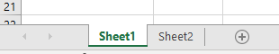
Copying sheets
The next step is to copy the data from Sheet1 to Sheet2. To view the earnings data in Sheet1, simply click on the Sheet1 tab. Select all of the cells that contain data by highlighting the top left cell (A1) and moving the mouse down and to the right until you reach cell F5. Copy the data by choosing Edit>Copy from the menu.
Or, hover your mouse over the highlighted data, right-click and select Copy from the menu that appears. Next, click on the Sheet2 tab, using the tab at the bottom of the page. All of the cells will be empty, but cell A1 of Sheet2 will be selected by default. We’re going to paste the data from Sheet1 in Sheet2.
Notes:
Let’s create the new worksheet in our Monthly Earnings spreadsheet file. You can rearrange the sheets by clicking and dragging them to the right or left

Slide 29

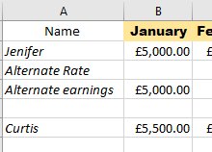
Since we’re starting with the same figure in both scenarios, type “=B2” in cell B4. This tells the worksheet to display whatever is in cell B2 in cell B4.
This is the result shown on the left .
Notes:
We want to show what happens when Jennifer’s earnings rise 1% per month compared to £50 per
month, using the same starting amount for January. The results for February will therefore reflect January earnings + 1%.

Slide 30

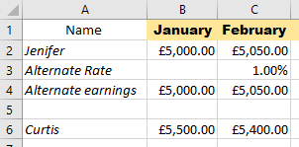
Sum Parentheses and PEMDAS
Now, select C4. This is where the alternate earnings for February, based on Jennifer’s 1% increase from the previous month, will appear. Type =“B4*C3” here.
This tells the spreadsheet to multiply the value in B4 (£5000) by the value in C3 (1%) and show the result.
In order to get the correct result we Entering “=B4*(1+C3)” in cell C4
Notes:
However, an unexpected result appears, The spreadsheet program would first multiply B4 ($5,000) by 1 and then add C3 (1%, or .01). This generates a result of $5,000.01. This is not what we want.
The order is Parentheses, Exponents, Multiplication, Division, Addition, and Subtraction, or PEMDAS
Note
You can experiment with the growth rate in row 3. Change a few cells to different values (for example,
1% in February, 2% in March, 1% in April, 2% in May, 3% in June), or change everything.

Slide 31
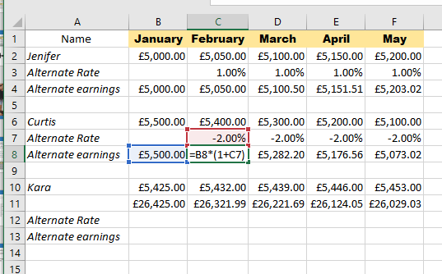
Declining percentages
1. In cell C7, type “-2%”, and drag that value across the row to column F (MAY).
2. Since we are starting at the same POUND amount in January for both methods, select cell B8 and type “=B6”
Notes:
Let’s start with Curtis. Add “Alternate rate (Curtis)” and “Alternate earnings (Curtis)” to the cells below his name. While we’re at it, let’s do the same for Kara. Curtis’ original scenario was a decrease of $100 per month. Let’s set it up so the decrease is 2% per month. Remember to change the cell to percentage from the drop down menu.
Can you think what formula shall we enter into cell C8 to calculate Curtis’ alternate earnings for February?
=B8*(1+C7)

Slide 32

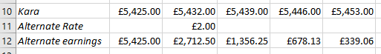
Spreadsheet division
Absolute cell referencing :
The $ refers to an absolute cell reference, which means that the formula is always in the specified cell . So when we drag the formular across it will always revert to this cell $C$11
Notes:
Kara’s monthly earnings, shown on row 10 in Sheet2, were originally projected to increase £7 per month. But Kara has decided she wants to transition to a new part-time role, and eventually leave the company in order to get her singing career off the ground. What will happen if her earnings are cut in half every month? It’s possible to follow the same model as Curtis, and use a rate that reflects a monthly decline of 50%. Or, simply multiply the previous month’s earnings by 50%. Let’s try another method:
division. Kara’s earnings are divided in half every month,

Slide 33
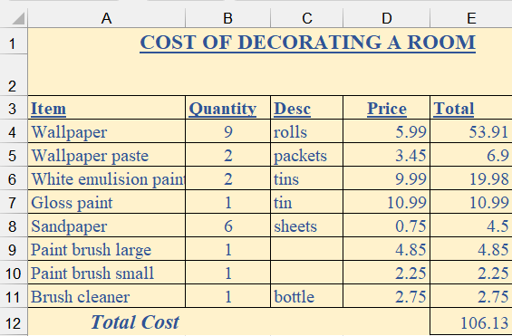
Quick Quiz + / * - =
In the chat facility answer the questions
Using cell referencing what would be the formula to find out the following:
Total price for the Wallpaper
Total cost without the Wallpaper
The total cost of 106.13
The customer can pay the cost in quarterly instalments
Stretch & Challenge :
So what would the formula be if you wanted to find out the average cost of the items ?
Notes:
Delete the yellow box covering each question 1 by 1
A =B4*D4
B =E12-E4
C =SUM(E4:E11)
D= E12/4
Stretch and challenge – total / number of items or use Average function

Slide 34
Prevent unauthorized access

Slide 35
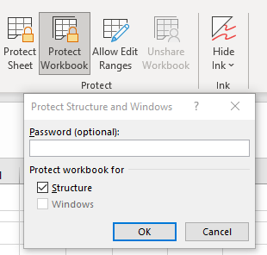
Control the changes users can make to workbooks
Learners :
Open Human Resources-1 from your sample files folder (if it isn’t already open).
Protect the structure of the workbook.
1. Click: Review→ Protect→ Protect Workbook.
The Protect Structure and Windows dialog is displayed.
2. Check the Structure check box (if necessary) and add a password.
3. Click the OK button.
4. Enter the password again when prompted and click OK.
Because you checked the Structure check box you are now unable to add, delete, rename, move, hide or unhide any of the worksheets in this workbook.

Slide 36
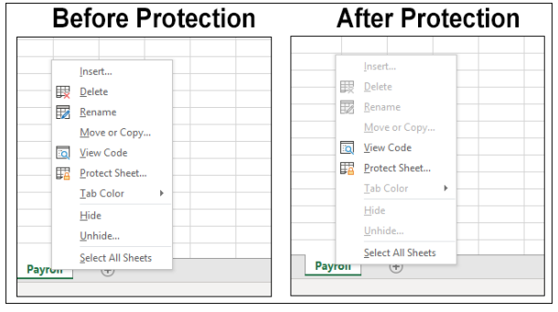
Notes:
Notice that the Unhide option is greyed out and unavailable. This has happened because you have protected the structure of the workbook. Notice also that the Insert, Delete, Rename, Move or Copy, Tab Colour and Hide options are now unavailable.
Remove password protection from the structure.
1. Click: Review→Protect→Protect Workbook. You are prompted for the password to remove protection: Enter the password and click the OK button. Protection is removed

Slide 37
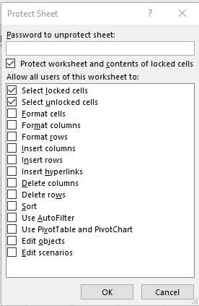
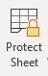
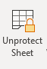
Restrict the cells users are allowed to change
Protect the Payroll worksheet so that the user is unable to change or select any of the locked cells.
Click: Review→Protect→Protect Sheet.
The Protect Sheet dialog appears
2. Uncheck the Select locked cells check box.
3. Enter a password
Click the OK button, confirm the password and then click the
OK button once more.
Unprotect the worksheet.
1. Click: Review→Protect→Unprotect Sheet
2. Enter the password, and then click the OK button.
3. The Lock cells B12:O16 need un-locking Do this in the
same way that you unlocked the cells, but this time check the Locked check box (instead of un-checking it).
4. Save your work as Human Resources-4.
Notes:
When you protect a worksheet, it is no longer possible to change the contents of a locked cell. The default settings allow the user to select (but not change) the contents of locked cells. This normally makes sense as you want the user to be able to copy and paste any part of the worksheet.
In this case, however, it creates a huge security problem as the user can easily copy the entire worksheet, paste it into a new worksheet, and then unhide the hidden rows.
For this reason, you want to prevent the user from selecting locked cells.
Notice that, the user can be prevented from doing many more things to the worksheet (such as formatting cells). You can selectively allow these actions by checking the appropriate check boxes.

Slide 38
Recap Question
Which actions are not allowed to perform in protected sheet?
A. Delete B. Hide
C. View Code D. tab colour
Which of the following will have broader protection ?
A. Protecting sheet B. protecting workbook
Why?

Slide 39
Dropdown lists

Slide 40
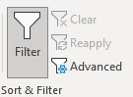
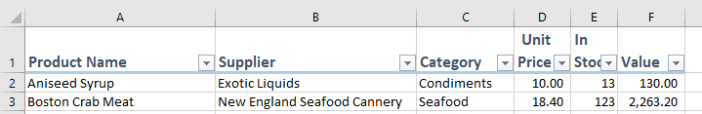

Apply a simple filter to a range
Open Inventory-1 from your sample files folder. This workbook contains a list showing all goods in stock. Add a filter to the range.
1. Click anywhere inside the range.
2. Click: Data→Sort & Filter→Filter.
Notice that small drop-down arrow buttons have appeared in the range header row:

Slide 41
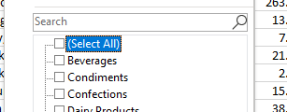
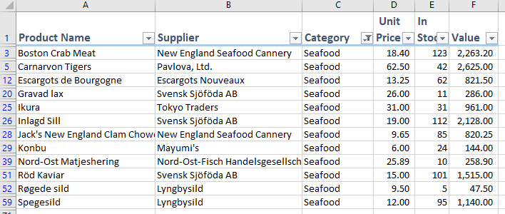
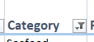
Use the filter to display products in the Seafood category.
1. Click the drop-down arrow to the right of Category in cell C1.
2. Uncheck the (Select All) check box.
3. Check the Seafood checkbox.
4. Click the OK button. Only Seafood products are
now displayed:
Notice that the filter button next to Category in cell C1 has changed to show that a filter condition is in effect.

Slide 42
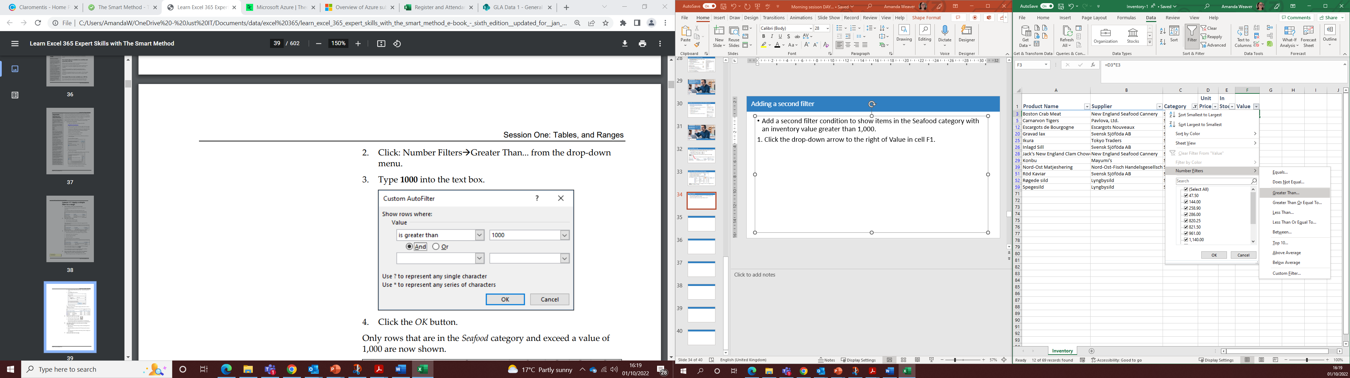
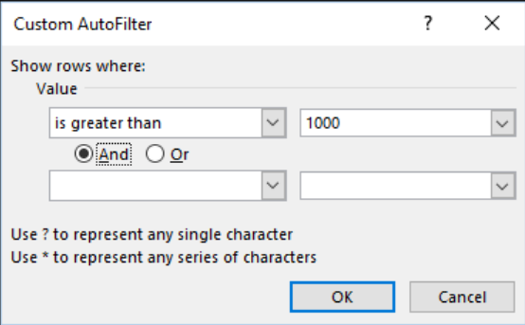
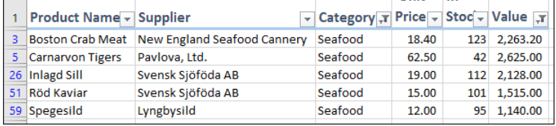
Adding a second filter
Add a second filter condition to show items in the Seafood category with an inventory value greater than 1,000.
Click the drop-down arrow to the right of Value in cell F1.
2. Click: Number Filters→Greater Than... from the drop-down menu.
3. Type 1000 into the text box.
4. Click the OK button.
Remove the filter from the range.
1. Click anywhere inside the range.
2. Click: Data→Sort & Filter→Filter.
Notes:
Answer:
Only rows that are in the Seafood category and exceed a value of 1,000 are now shown. To remove all filters you can select clear filters
Notice that the small drop-down handles have disappeared from the range header row and that all rows are now displayed.

Slide 43
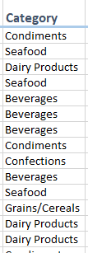
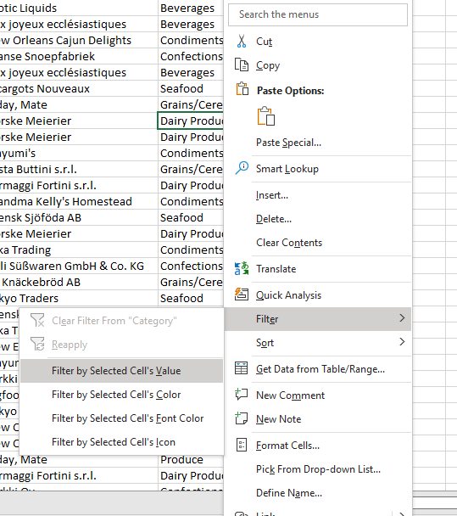
Filter by selection to only
Right-click any cell in the Category column containing the text: Dairy Products. Select Filter by Selected Cell’s Value from the shortcut menu.
Remove the filter from the range as before.

Slide 44
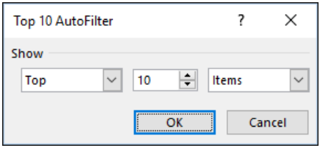
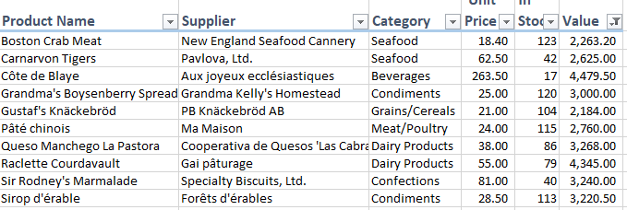

Apply a top 10 and custom filter to a range
Click anywhere inside the range and then click: Data→Sort & Filter→Filter
Click the drop-down arrow to the right of Value in cell F1.
Click: Number Filters.
Click: Top 10... from the fly-out menu. The Top 10 AutoFilter dialog is displayed:
Notes:
It is possible to use this dialog to filter to a number other than 10 or to filter to the Bottom values (if you wanted to show the items with the least expensive inventory).
The ten items with the most expensive inventory are shown. Note that they are still sorted alphabetically, in ascending order, by Product Name

Slide 45
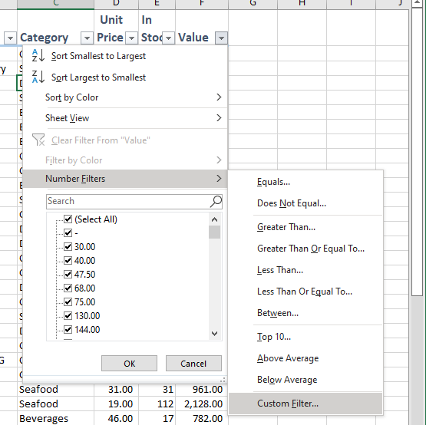
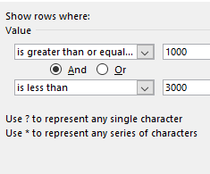

Custom Filters
Use a custom filter to show items that have a value between 1,000 and 3,000.
1.Click the drop-down arrow to the right of Value in cell F1.
2. Click: Number Filters→Custom Filter on the drop-down menu.
3. Set the filter condition to: is greater than or equal to 1000 And is less than or equal to 3000.
4. Click the OK button. Only products with a value between 1,000 and 3,000 are shown

Slide 46
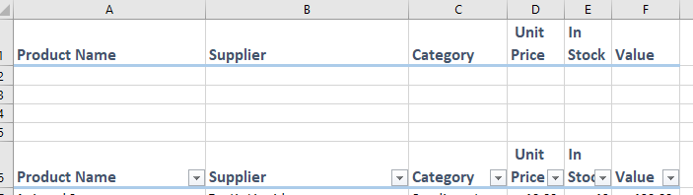
Apply an advanced filter with multiple OR criteria …..
Insert five blank rows at the top of the worksheet.
Copy the range headers from row 6 to row 1.
Your worksheet should now look like this:

Slide 47
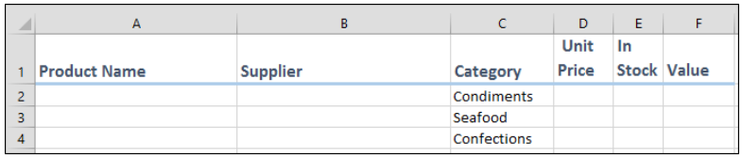
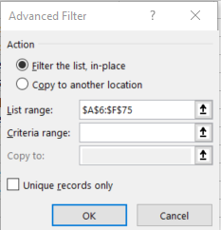
Apply an advanced filter with multiple OR criteria……
This is an example of a filter with three OR criteria. The filter can be defined as: Condiments OR Seafood OR Confections. Type these categories into the column as below.
Click anywhere in the large range to be filtered (any cell in the range A6:F75).
Click: Data→Sort & Filter→Advanced.
Notes:
So what we are going to do it use each of the rows 2-4 can now be used to define the criteria needed for each column in the range.
The Advanced Filter dialog is displayed with the range already defined. Because you clicked within the range in step one you have saved yourself the trouble of manually selecting the range.

Slide 48
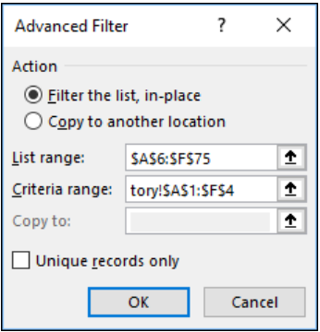
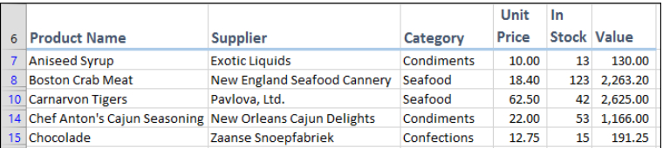

Continued …..
3. Click in the Criteria range text box.
4. Select the range A1:F4 with the mouse.
The criteria range appears as: Inventory!$A$1:$F$4 This is a fully qualified cell reference. It means the range A1:F4 on the Inventory worksheet.
5. The range is now filtered to display only Condiments, Seafood and Confections.
Notes:
Notice also the dollar signs shown before each number and letter. These denote absolute cell reference. Absolute and Relative cell references
Save your work as Inventory-2.

Slide 49
Plenary- so today we have looked at how to …
Import data and exporting data
Format by:
Embedding an Excel chart object into a Word document
Security :
Prevent unauthorized users from opening or modifying workbooks
Control the changes users can make to workbooks
The efficiency of the use of Functions and worked with:
Drop down lists
Filter
Sort

